Slide 1
Intro to Python – Part 2
COP 4020
University of Central Florida

Slide 2
Logic – Booleans
>>> b = True
>>> c = False
>>>
>>> 2 > 3
False
>>> 2 < 3
True
>>> 2 >= 3
False
>>> 2 <= 3
True
>>> 2 == 3
False
>>> 2 != 3
True
>>> type(2<3)
<class 'bool'>
>>>

Slide 3
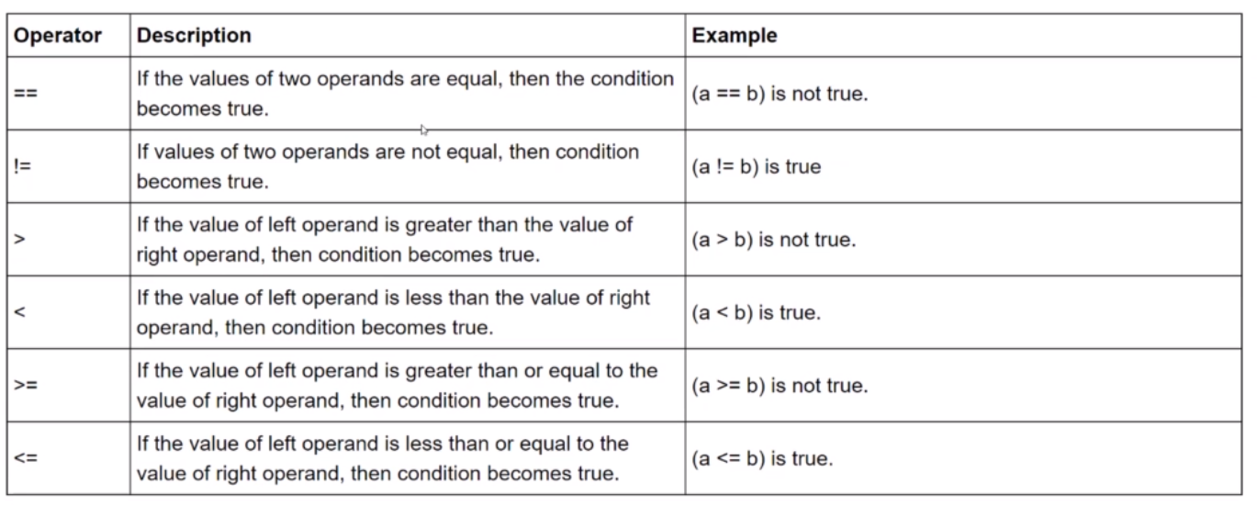
Comparisons

Slide 4
if Statements
if condition:
code…
num1 = 100
num2 = 50
if num1 > num2:
print("num1 is bigger than num2")

Slide 5
Using else
if condition:
code…
else:
alternative code…
num1 = 100
num2 = 50
if num1 > num2:
print("num1 is bigger than num2")
else:
print("num1 is not bigger than num2")

Slide 6
Using elif
If condition:
code…
elif other condtion:
code…
else:
code…
num1 = 100
num2 = 50
if num1 > num2:
print("num1 is bigger than num2")
elif num1 < num2
print("num1 is less than num2")
else:
print("num1 is the same as num2")

Slide 7
More Logic
not 3 > 1
not 4 ==3
x = 10
y = 20
if not y < x:
print("It worked")

Slide 8
Compound Conditions
Chaining
>>> 1 < 2 < 3
True
>>> 1 < 2 > 3
False
Using and
>>> 1 < 2 and 2 > 3
False

Slide 9
Continued
>>> 'h' == 'h' and 2 == 2
True
>>> ('h' == 'h') and (2 == 2)
True
>>> 1 == 1 or 2 == 2
True
>>> 1 == 0 or 2 == 2
True

Slide 10
Lists
>>> [1,2,3,4,5]
[1, 2, 3, 4, 5]
>>> myList = [1,2,3,4,5]
>>> myList
[1, 2, 3, 4, 5]
>>> ["Sam", "George", "Fred"]
['Sam', 'George', 'Fred']
>>> yourList = [1,"Test",2.75]
Lists support indexing and slicing.
Lists can be nested

Slide 11
Working With Lists
>>> myList = [1,2,3]
>>> len(myList)
3
>>> myList[0]
1
>>> >>> myList[1:]
[2, 3]

Slide 12
More Lists
>>> myList = [1,2,3]
>>> yourList = [7,8,9]
>>> ourList = myList + yourList
>>> ourList
[1, 2, 3, 7, 8, 9]
Lists are mutable
>>> ourList[0] = 14
>>> ourList
[14, 2, 3, 7, 8, 9]

Slide 13
More Lists
>>> ourList.append(144)
>>> ourList
[14, 2, 3, 7, 8, 9, 144]
>>> ourList.pop()
144
>>> ourList
[14, 2, 3, 7, 8, 9]

Slide 14
More Lists
>>> ourList.pop(1)
2
>>> ourList
[14, 3, 7, 8, 9]
>>> newList = ['a','e','x','b','c']
>>> numList = p4,1,8,3]
>>> numList = [4,1,8,3]
>>> newList.sort()
>>> newList
['a', 'b', 'c', 'e', 'x']
>>> numList.sort()
>>> numList
[1, 3, 4, 8]

Slide 15
More Lists
>>> newList.reverse()
>>> numList.reverse()
>>> newList
['x', 'e', 'c', 'b', 'a']
>>> numList
[8, 4, 3, 1]

Slide 16
Dictionaries
Dictionaries are unordered mappings for storing objects (as opposed to lists which are in ordered sequences).
It utilizes a key-value pair to access objects, and an index for its location isn’t necessary.
Dictionaries use curly braces and colons to signify the keys and their associates values.
{'key1':'value1','key2':'value2'}

Slide 17
Using Dictionaries
>>> myDictionary = {'key1':'value1','key2':'value2'}
>>> myDictionary
{'key1': 'value1', 'key2': 'value2'}
>>> myDictionary['key2']
'value2’
>>> pricesLookup = {'apple':2.99,'banana':0.75,'wine':9.99}
>>> pricesLookup
{'apple': 2.99, 'banana': 0.75, 'wine': 9.99}
>>> pricesLookup['apple']
2.99

Slide 18
Variations
Data types inside of dictionaries can be just about anything including values, lists, and dictionaries.
d = {'k1':123,'k2':[1,2,3],'k3':{'insideKey':100}}
Adding to a dictionary
>>> d = {'k1':100,'k2':200}
>>> d
{'k1': 100, 'k2': 200}
>>> d['k3'] = 300
>>> d
{'k1': 100, 'k2': 200, 'k3': 300}

Slide 19
More About Dictionaries
Changing Values
>>> d
{'k1': 100, 'k2': 200, 'k3': 300}
>>>
>>> d['k1'] = "New String"
>>> d
{'k1': 'New String', 'k2': 200, 'k3': 300}

Slide 20
Extras
>>> d.items()
dict_items([('k1', 'New String'), ('k2', 200), ('k3', 300)])
>>> d.keys()
dict_keys(['k1', 'k2', 'k3'])
>>> d.values()
dict_values(['New String', 200, 300])

Slide 21
Tuples
Tuples are similar to lists but are immutable
Once an element is inside a tuple, it cannot be reassigned
Tuples use parentheses: (1,2,3)
Example:
myTuple = (1,2,3)

Slide 22
>>> t = (1,2,3)
>>> myList = [1,2,3]
>>> type(t)
<class 'tuple'>
>>> type(myList)
<class 'list'>
>>> len(t)
3
>>> t = ('one',2)
>>> t
('one', 2)
>>> t[0]
'one'
>>> t[1]
2
>>> t[-1]
2
>>>

Slide 23
>>> t = ('a','a','b')
>>> t.count('a')
2
>>> t.index('a')
0
>>> t.index('b’)
2
>>> myList[0] = 'NEW'
>>> myList
['NEW', 2, 3]
>>> t[0] = 15
Traceback (most recent call last):
File "<pyshell#27>", line 1, in <module>
t[0] = 15
TypeError: 'tuple' object does not support item assignment

Slide 24
Sets
Sets are unordered collections of unique elements
This means that there can only be one representative of the same object
>>> myset = set()
>>> myset.add(1)
>>> myset
{1}
>>> myset.add(2)
>>> myset
{1, 2}
>>> myset.add(2)
>>> myset
{1, 2}

Slide 25
Casting a List to Unique Values
>>> mylist = [1,2,2,3,4,4,5,6,6,7]
>>> myset = set(mylist)
>>> myset
{1, 2, 3, 4, 5, 6, 7}

Slide 26
Using Sets
Write an expression that world turn the string 'Mississippi' int a set of unique letters.
>>> state = "Mississippi"
>>> uniqueLetters = set(state)
>>> uniqueLetters
{'M', 'i', 's', 'p’}

Slide 27
File I/O
First, we need to tend to the current directory.
import os in order to have the methods with which we get or set the current directory.
>>> import os
>>> os.getcwd()
'C:\\Program Files (x86)\\Python37-32'
>>> os.chdir('d:\work\python')
>>> os.getcwd()
'd:\\work\\python'
myfile.txt has been created in d:\work\python

Slide 28
Opening a File
>>> myfile = open('myfile.txt')
>>> myfile.read()
'Hello. This is a text file.\nThis is the second line.\nThis is the third line.'
>>> myfile.read()
''
>>> myfile.seek(0)
0
>>> contents = myfile.read()
>>> contents
'Hello. This is a text file.\nThis is the second line.\nThis is the third line.'

Slide 29
Reading a Line
You can read all lines into a list.
>>> lines = myfile.readlines()
>>> lines
['Hello. This is a text file.\n', 'This is the second line.\n', 'This is the third line.']
>>> lines[0]
'Hello. This is a text file.\n'
>>> lines[0].rstrip('\n')
'Hello. This is a text file.'

Slide 30
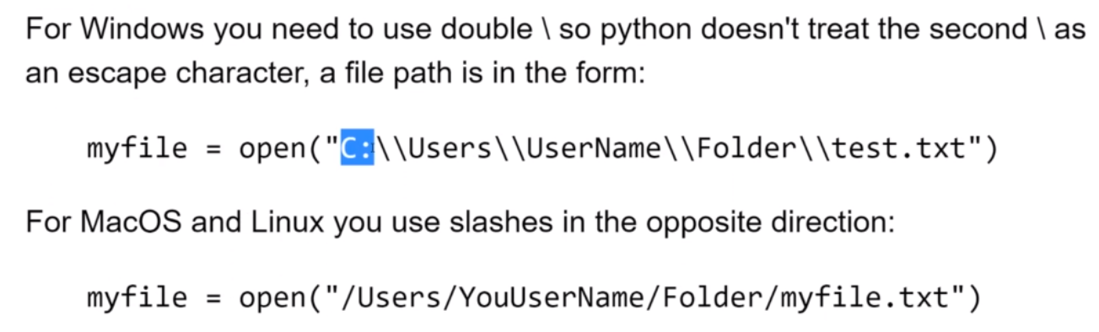
File Paths

Slide 31
Closing
You need to close files
myfile.close()
Or
with open('myfile.txt’) as my_new_file:
contents = my_new_file.read()

Slide 32
Writing to Files
>>> yourfile = open('yourfile.txt', mode='w')
>>> yourfile.write('Hello World!!!')
14
>>> yourfile.close()
Or
>>> with open('yourfile.txt',mode='a') as f:
f.write('Hello Moon!!!')
13

Slide 33
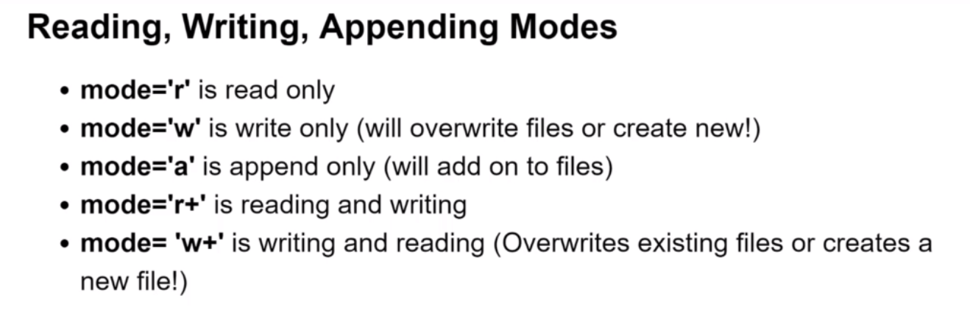
File Modes

Slide 34
For Loops
The term iterable means you can iterate over the object
For example, you can iterate over every character in a string, iterate over every item in a list, iterate over every key in a dictionary.
>>> myIterable = [1,2,3]
>>> for item in myIterable:
print(item)
1
2
3

Slide 35
Examples
>>> for num in mylist:
if num % 2 == 0:
print(num)
2
4
6
8
10

Slide 36
Examples
>>> for num in mylist:
if num % 2 == 0:
print(num)
else:
print('Odd Number')
Odd Number
2
Odd Number
4
Odd Number
6
Odd Number
8
Odd Number
10
print(f'Odd Number: {num}')

Slide 37
Keep a Running Tally
>>> listSum = 0
>>> for num in mylist:
listSum = listSum + num
>>> print(listSum)
55

Slide 38
Iterating a String
>>> mystring = 'Hello World'
>>> for letter in mystring:
print(letter)
H
e
l
l
o
W
o
r
l
d

Slide 39
Alternative
>>> for _ in mystring:
print('Cool')
Cool
Cool
Cool
Cool
Cool
Cool
Cool
Cool

Slide 40
More
tup = (1,2,3)
for item in tup:
print(item)
1
2
3

Slide 41
Unpacking
mylist = [(1,2),(3,4),(5,6),(7,8)]
len(mylist)
4
for item in mylist:
print(item)
(1,2)
(3,4)
(5,6)
(7,8)

Slide 42
More Unpacking
for (a,b) in mylist:
print(a)
1
3
5
7
mylist = [(1,2),(3,4),(5,6),(7,8)]
for (a,b) in mylist:
print(a)
print(b)
1
2
3
4
5
6
7
8
Note: You can skip the tuple parentheses
for a,b in mylist:
print(a)
print(b)

Slide 43
One More
mylist = [(1,2,3),(5,6,7),(9,10,11)]
for a,b,c in mylist:
print(b)
2
6
10

Slide 44
Iterate Through Dictionary
d = {'k1':1, 'k2':2, 'k3':3}
for item in d:
print(item)
k1
k2
k3

Slide 45
Iterate Through Dictionary for Items
d = {'k1':1, 'k2':2, 'k3':3}
for item in d.items():
print(item)
('k1',1)
('k2',2)
('k3',3)

Slide 46
Unpacking
d = {'k1':1, 'k2':2, 'k3':3}
for key,value in d.items():
print(value)
1
2
3

Slide 47
Values
d = {'k1':1, 'k2':2, 'k3':3}
for value in d.values():
print(value)
1
2
3

Slide 48
While Loops
>>> status = 0
>>> while status < 10:
print(status)
status = status + 1
0
1
2
3
4
5
6
7
8
9

Slide 49
Adding an Else
>>> status = 0
>>> while status < 10:
print(status)
status = status + 1
else:
print('done')
0
1
2
3
4
5
6
7
8
9
done

Slide 50
Note: Same Math Shortcuts
a = 4
b = 5
a += b
a -= b
a *= b
a /= 3

Slide 51
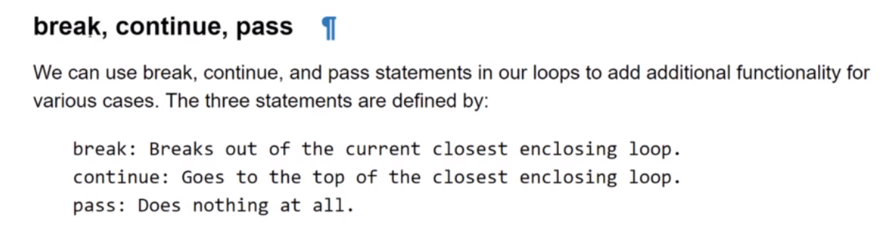
More Contro

Slide 52
Pass Explained
x = [1,2,3]
for item in x:
#comment ← error, nothing in loop
for item in x:
pass

Slide 53
Useful Operators
for num in range(10):
print(num)
0
1
2
3
4
5
6
7
8
9
for num in range(3,10):
print(num)
3
4
5
6
7
8
9

Slide 54
Adding Step Size
for num in range(0,10,2):
print(num)
0
2
4
6
8

Slide 55
Generating a List of Numbers
list(range(0,11,2))
[0,2,4,6,8,10]

Slide 56
Enumerating
cnt = 0
word = 'abcde'
for letter in 'abcde':
print(word[cnt])
cnt += 1
a
b
c
d
e
word = 'abcde'
for item in enumerate(word):
print(item)
(0, 'a')
(1, 'b')
(2, 'c')
(3, 'd')
(4, 'e')

Slide 57
word = 'abcde'
for index,letter in enumerate(word):
print(index)
print(letter)
0
a
1
b
2
c
3
d
4
e

Slide 58
Zip
mylist1 = [1,2,3,4,5]
mylist2 = ['a', 'b', 'c', 'd', 'e’]
for item in zip(mylist1,mylist2):
print(item)
(1, 'a')
(2, 'b')
(3, 'c')
(4, 'd')
(5, 'e')
'
'

Slide 59
More Zip
mylist1 = [1,2,3,4,5]
mylist2 = ['a', 'b', 'c', 'd', ‘e’]
mylist3 = [100,200,300,400,500]
for item in zip(mylist1,mylist2,mylist3):
print(item)
(1, 'a', 100)
(2, 'b', 200)
(3, 'c', 300)
(4, 'd', 400)
(5, 'e', 500)
Note: Zip stops at the minimum length
'
'

Slide 60
In Operator
'x' in [1,2,3]
'x' in ['x', 'y', 'z']
'a' in 'a world'

Slide 61
In Dictionary
'mykey' in {'mykey':345}

